Slide 1
Masterize your Degree
Sahitya Reddy Bollavaram - 4849759

Slide 2
Overview
Greenfield System
Platform for all the students of University of Genoa’s Master course, Supervisors, Reviewers, and other faculty members involved in the process of getting a degree.

Slide 3
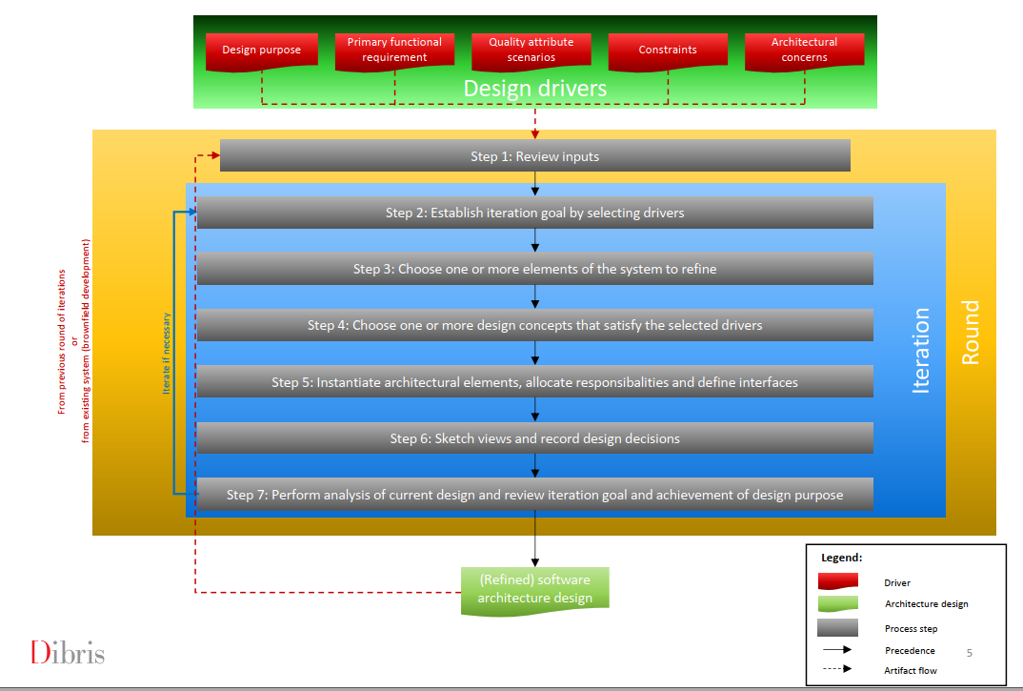
ADD Method

Slide 4

Reviewing Inputs
Category | Details | Description
Design Purpose | This is a greenfield system and the purpose of this system is to produce a sufficiently detailed design to support the construction of the system. | -
Primary Functional Requirements | R13, R14, R15, R16, R8, R24, R18, R17, R21, R10, R22, R23, R6, R3, R9 | Because they all support the core functionality of the system.
Non-Functional Requirements | R19, R25, R26, R27 | Because they impact the architecture of the system.
Other Functional Requirements | R1, R2, R20, R5 | Additional Features.
Other Non-functional Requirements | R11, R2, R7, R12, R20, R5, R4, R6, R17. | Involves requirements related to Privacy, UI, interaction.

Slide 5
Iteration1:
The main goal is to achieve the architecture of the system by choosing the drivers that may influence the general structure of the system.

Slide 6
Step 2: Establishing Iteration goal by selecting drivers:
For this step, the requirements classified as Primary Functional Requirements and Non-Functional Requirements are considered.

Slide 7
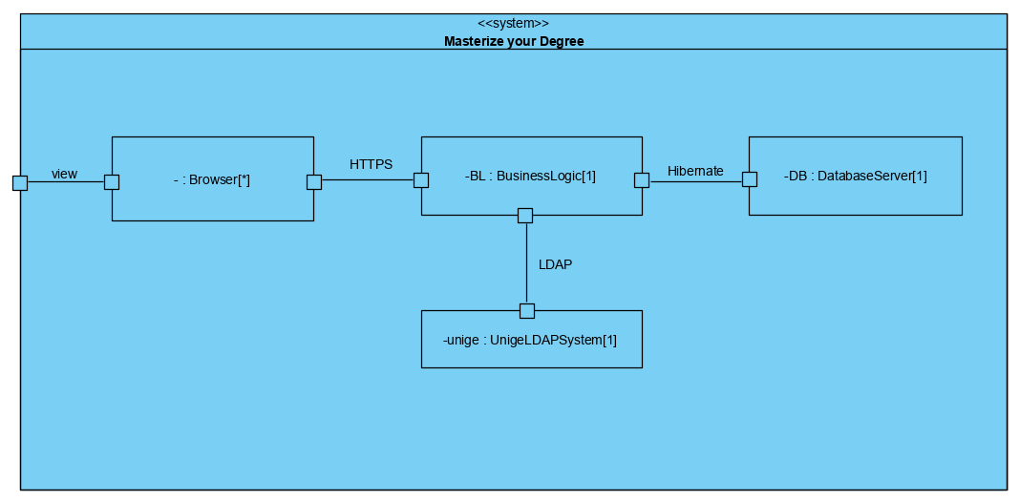
Step 3: One or More Elements of the System are chosen to refine:
Figure 1: Composite Structure diagram for Masterize your degree system

Slide 8
Step 4: Design concepts that satisfy the drivers selected are chosen in this step
Design Decisions and Locations | Rationale
Logically structure the client part of the system using Web Application reference Architecture. | This reference architecture is oriented towards the development of applications that are accessed from a web browser and for applications that can adapt to whichever device the user is viewing on. Since this system does not need any fancy and rich interface, something as simple as a web application would do the job. Discarded Alternatives: Rich Internet applications Mobile Applications
Logically structure the server part of the system using the Service Application reference architecture. | Service applications do not provide a user interface but rather expose services that consumed by other applications. No other alternatives were considered and discarded, as the architect was familiar with this reference architecture and considered it fully adequate to meet the requirements.
Build the application using Spring Java framework and other UI technologies. | Spring framework is one of the standard frameworks for building service applications and web applications. Another reason for choosing Java based applications is due to the fact that the developers are well versed in it.

Slide 9
Step 5: Instantiating Architectural Elements, Allocating Responsibilities, and Defining Interfaces
The next iteration has a better explanation about the elements and their functionalities since it is typically too early to define them here.

Slide 10
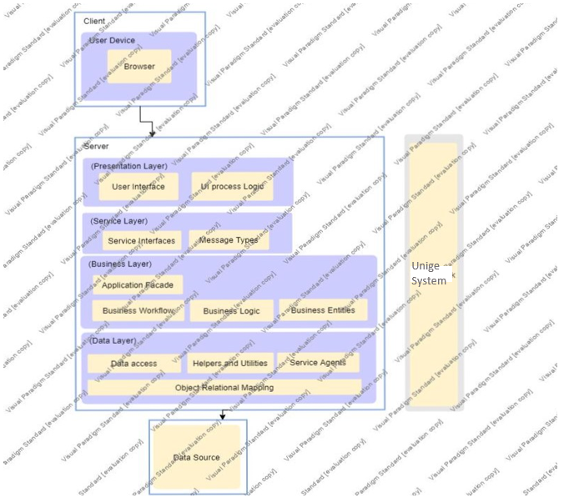
Step 6: Sketch Views and Record Design Decisions
Figure 2: Module View of Masterize your Degree

Slide 11
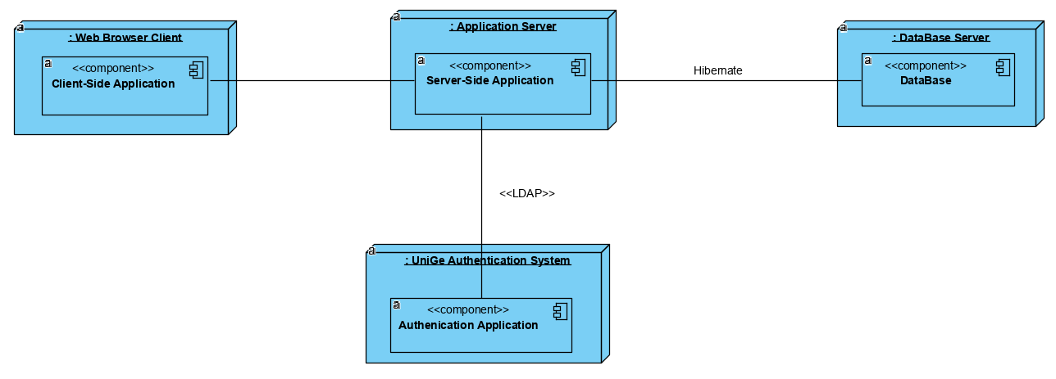
Step 6: Sketch Views and Record Design Decisions
Figure 3: Initial deployment diagram of Masterize a degree system

Slide 12
Step 7: Performing Analysis of Current Design and Reviewing Iteration Goal and Achievement of Design Purpose
• Design progress summarized using a Kanban board

Slide 13
Iteration 2
In this iteration, a more detailed description of the functionalities mentioned above in iteration 1 are focussed on, that will drive the implementation.

Slide 14
Step 2: Establish Goal by Selecting Drivers
The goal of this iteration is to address and identify structures to support primary functionality.
In this second iteration, the same requirements as the above iteration are considered to show a detailed description.

Slide 15
Step 3: Choosing One or More Elements of the System to Refine
The elements that will be refined in this iteration are the modules located in the different layers defined by the two reference architectures from the previous iteration. In general, the support of functionality in this system requires the collaboration of components associated with modules that are located on different layers.

Slide 16
Step 4: Choosing One or More Design Concepts that Satisfy the Selected Drivers
Design Decisions and Location | Rationale and Assumptions
Entity Relationship Diagram | The entities that participate in the primary use cases are identified and modelled using E-R diagrams to accelerate the phase of design.
Mapping the system requirements to the class diagram of the application. | Moving from an abstract representation of the data model to a static structure and behaviour of the proposed system using class diagrams.
Connect components associated with modules using Spring Boot. | This framework uses an inversion of control approach that allows different aspects to be supported and the modules to the unit-tested.
Associate frameworks with a module in the data layer. | ORM Mapping is encapsulated in the modules that are contained in the data layer. This Hibernate framework previously selected is associated with these modules.

Slide 17
Step 5: Instantiating Architectural Elements, Allocating Responsibilities, and Defining Interfaces
Design Decisions and Location | Rationale and Assumptions
Data Access Object Pattern (structural pattern) for accessing data. | The functionality of this pattern is to hide from the application all the complexities involved in performing CRUD operations in the underlying storage mechanism. This permits both layers to evolve separately without knowing anything about each other.
Data transfer object design pattern used to transfer data between software application subsystems. | Since each call to any remote interface is expensive, response to each call should bring as much data as possible. So, if multiple requests are required to bring data for a particular task, data to be brought can be combined in a DTO so that only one request can bring all the required data.
Strategy Pattern for defining the manner in which communication between classes or entities takes place. | You can isolate the implementation details of an algorithm from the code that uses it. (Loose coupling which is compatible with spring class relation concepts). Discarded Alternative: Façade Pattern

Slide 18
Step 6: Sketching Views and Recording Design Decisions
Please refer to the masterizeyourdegree.vpp file for E-R diagram.
For class diagrams please refer to the file masterizeyourdegree.vpp.

Slide 19
Step 7: Performing Analysis of Current Design and Reviewing Iteration Goal and Achievement of Design Purpose
• Design progress summarized using a Kanban board

Slide 20
Iteration 3: Addressing the user interaction, Privacy requirements and Communication
These requirements are categorized into three:
Privacy which defines the authentication and role management;
Interaction which involves the UI design;
Communication which involves the requirements that fall under email system or forums for interaction.

Slide 21
Step 2: Establish Iteration Goal by Selecting Drivers
For this iteration, privacy and role management requirements, interaction, and informing requirements are focused on.

Slide 22
Step 3: Choosing One or More Elements of the System to refine
For this step, the elements that will be refined are elements of the business logic layer and the presentation layer which provide additional functionalities to the already present system.

Slide 23
Step 4: Choose One or More Design Concepts That Satisfy the Selected Drivers
Design Decision and Location | Rationale and Assumptions
For control access we use the LDAP RBAC. | In this way we can create, delete users from the system also for the permissions, defining new roles and access methods for the system.
For informing system, Spring Mail system is used. | It is integrated with Spring. Discarded alternatives: Java Mail Service
For requirements which involve things to be shown on the UI, HTML and JavaScript is suggested. | All the developers seemed to be familiar with HTML and JavaScript.
JUnits must be implemented for all the requirements. | Different scenarios for JUnits testing must be done by the developers. This can ensure that there would be no errors in the inputs.

Slide 24
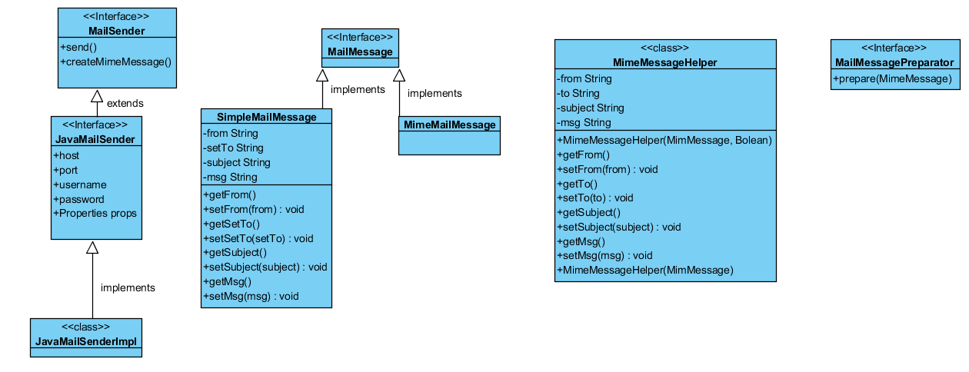
Step 5: Instantiating Architectural Elements, Allocate Responsibilities, and Define Interfaces

Slide 25
Step 6: Evaluation of the Requirements
• Design progress summarized using a Kanban board

